Slide 1
Capstone Project - The Battle of Neighborhoods
Finding the best place to open an Italian restaurant in Toronto

Slide 2
Introduction
The objective of this project is to use Foursquare location data and regional clustering of venue information to determine what might be the ‘best’ neighborhood in Toronto to open a restaurant.
Through this project, we will find the most suitable location for an entrepreneur to open a new Italian restaurant in Toronto, Canada.

Slide 3
Data acquisition and cleaning
The data that will be required will be a combination of CSV files that have been prepared for the purposes of the analysis from multiple sources which will provide the list of neighbourhoods in Toronto (via Wikipedia), the Geographical location of the neighbourhoods (via Geocoder package) and Venue data pertaining to Italian restaurants (via Foursquare).

Slide 4
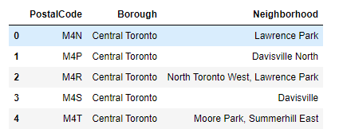
After the implementation of several assumptions, the rows were grouped based on the borough as shown below:

Slide 5
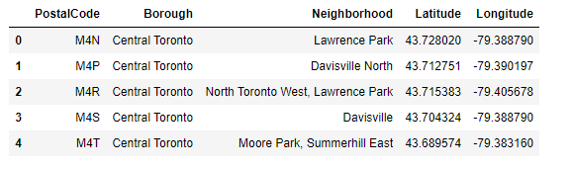
Using the Latitude and Longitude collected from the Geocoder package, we merged the two tables together based on Postal Code.

Slide 6
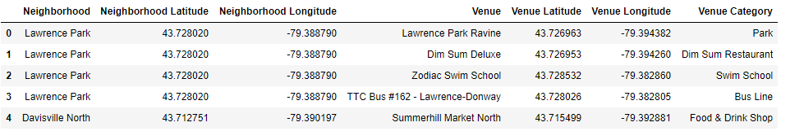
We then merged the Foursquare Venue data with the Neighborhood data which then gave us the nearest Venue for each of the Neighborhoods.

Slide 7
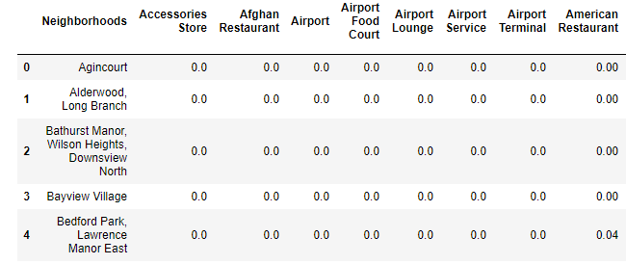
For each of the neighborhoods, individual venues were turned into the frequency at how many of those Venues were located in each neighborhood. Then we grouped those rows by Neighborhood and by taking the average of the frequency of occurrence of each Venue Category.

Slide 8
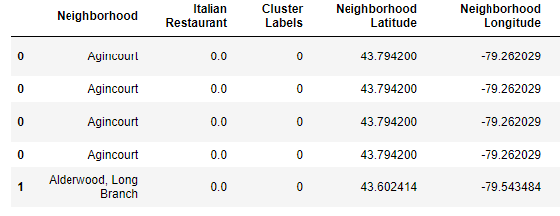
To make the analysis more interesting, we wanted to cluster the neighborhoods based on the neighborhoods that had similar averages of Italian Restaurants in that Neighborhood.

Slide 9
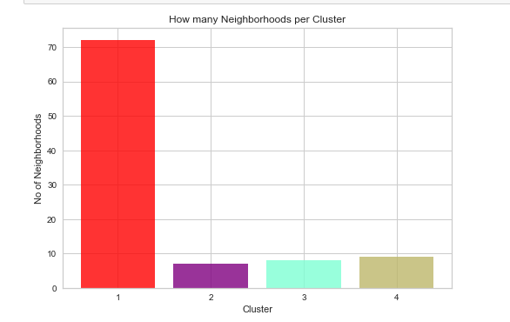
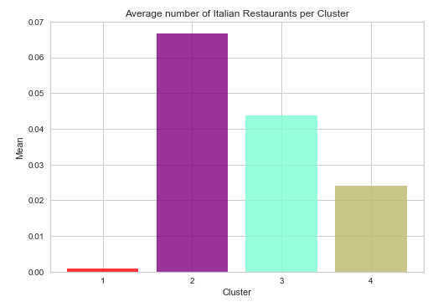
We have a total of 4 clusters. Before we analyze them one by one let's check the total amount of neighborhoods in each cluster and the average Italian Restaurants in that cluster.

Slide 10
Conclusion
Most of the Italian Restaurants are in cluster 2 represented by the purple clusters. The Neighborhoods located in the North York area that have the highest average of Italian Restaurants are Bedford Park and Lawrence Manor East. This concludes the optimal findings for this project and recommends the entrepreneur to open an authentic Italian restaurant in these locations with little to no competition. Nonetheless, if the food is authentic, affordable and good taste, I am confident that it will have great following everywhere.

